Slide 1



Ultra-Deep Cohorts for Planetary Scale Evolution
Andrew Seacord¹,Rayan Chikhi³, Danielle Callan², Steven Weaver², Patrik Smeds¹, Sergei L. Kosakovsky Pond², Anton Nekrutenko¹
¹The Pennsylvania State University, ²Temple University, ³Institut Pasteur

Slide 2
Goal / Problem
Goal: Planetary-scale genomic analysis, especially for selection analysis of rapidly-evolving pathogens.
Problem: 2 bottlenecks
Sequence Read Archive (SRA) has incomplete and often inaccurate metadata. Discovery of specific sequences is extremely challenging.
Evolutionary selection analysis is slow. Contemporary software relies on asymptotically-complex algorithms that do not scale.

Slide 3
Sequence Discovery — Logan
Assemblers: Reads → Unitigs → Contigs → Sequence
Logan stores unitigs and contigs for every SRA accession
Unitigs can be searched via Bloom filters (Kmindex)
Contigs can be searched via alignment (LexicMap)

Slide 4

Large-Scale Selection Analysis — HyphAeon
HyphAeon is a small neural network that can recognize patterns in codons thousands of times faster than traditional tree-based methods
HyphAeon does selection analysis (meme, epistasis, etc.)
the partner module, ChronAeon, does molecular clock dating
neural networks bypass the bottleneck of asymptotically-complex tree searches

Slide 5
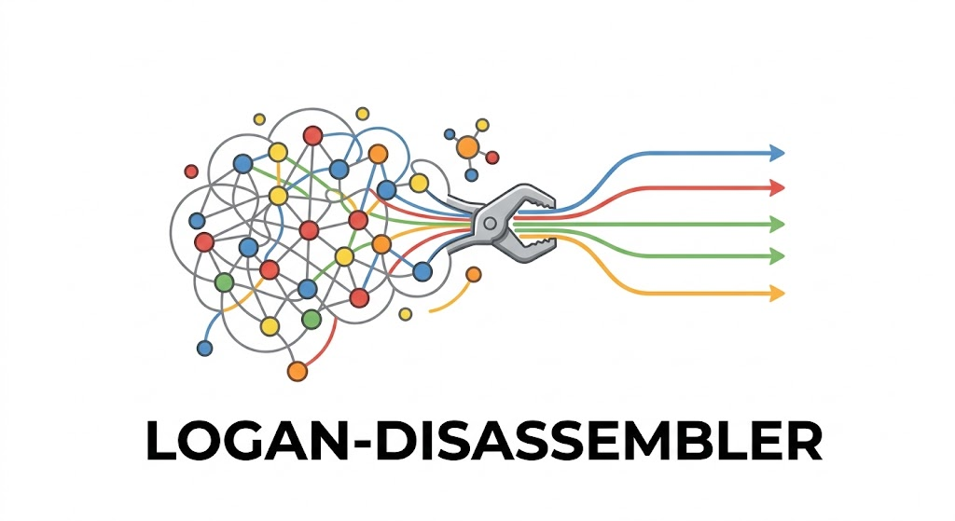
Bridging the Gap — Disassembler
How do we feed Logan into HyphAeon?
  Logan offers unitigs and contigs
  HyphAeon requires MSA
the Disassembler package
  Rust/Python tool suite for turing Logan output into a HyphAeon-ready MSA
  2 main pathways:
    LexicMap pathway (quick, broad analysis)
    Kmindex pathway (slow, meticulous analysis)

Slide 6
The Kmindex Pathway
Kmindex is a tool for calculating the percentage of shared k-mers between a query and reference
Disassembler uses a protein coding sequence as a query and runs Kmindex to compare it against Logan’s pre-computed Bloom filters
Result: List of SRA accessions and their k-mer % identities to the query
Matching accessions → stream unitigs from AWS S3 → Logan Walker → MSA

Slide 7
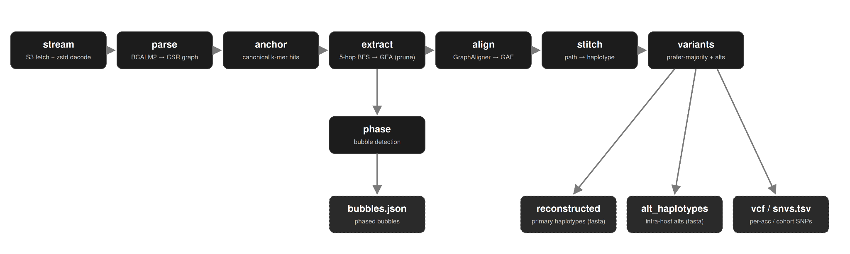
Logan Walker
unitigs are parsed into a Compressed Sparse Row (CSR) graph
“anchor” regions are identified by additional k-mer matching of query
subgraphs are made by expanding out from anchors and then are aligned by GraphAligner
a legitimate path through the alignment is stitched together to make a haplotype

Slide 8
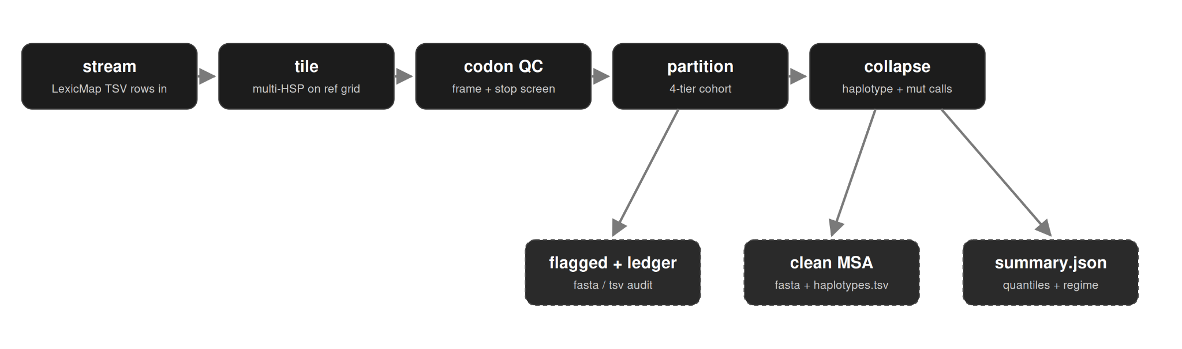
The LexicMap Pathway
LexicMap goes straight for the alignments
contigs vs. unitigs

Slide 9
Disassembler is not an Assembler
Assembly is about compressing (Reads → Unitigs → Contigs)
  Logan has done this for us already
  Disassembler takes these pre-assembled intermediates and goes backwards, trying to find the information that gets hidden in the usual compression steps
Assemblers do not have a general target
  Disassembler constructs everything based on the query sequence
Result: Pre-computed, searchable Logan sequences → Realistic haplotypes per
accession that can be aligned and analyzed via HyphAeon

Slide 10
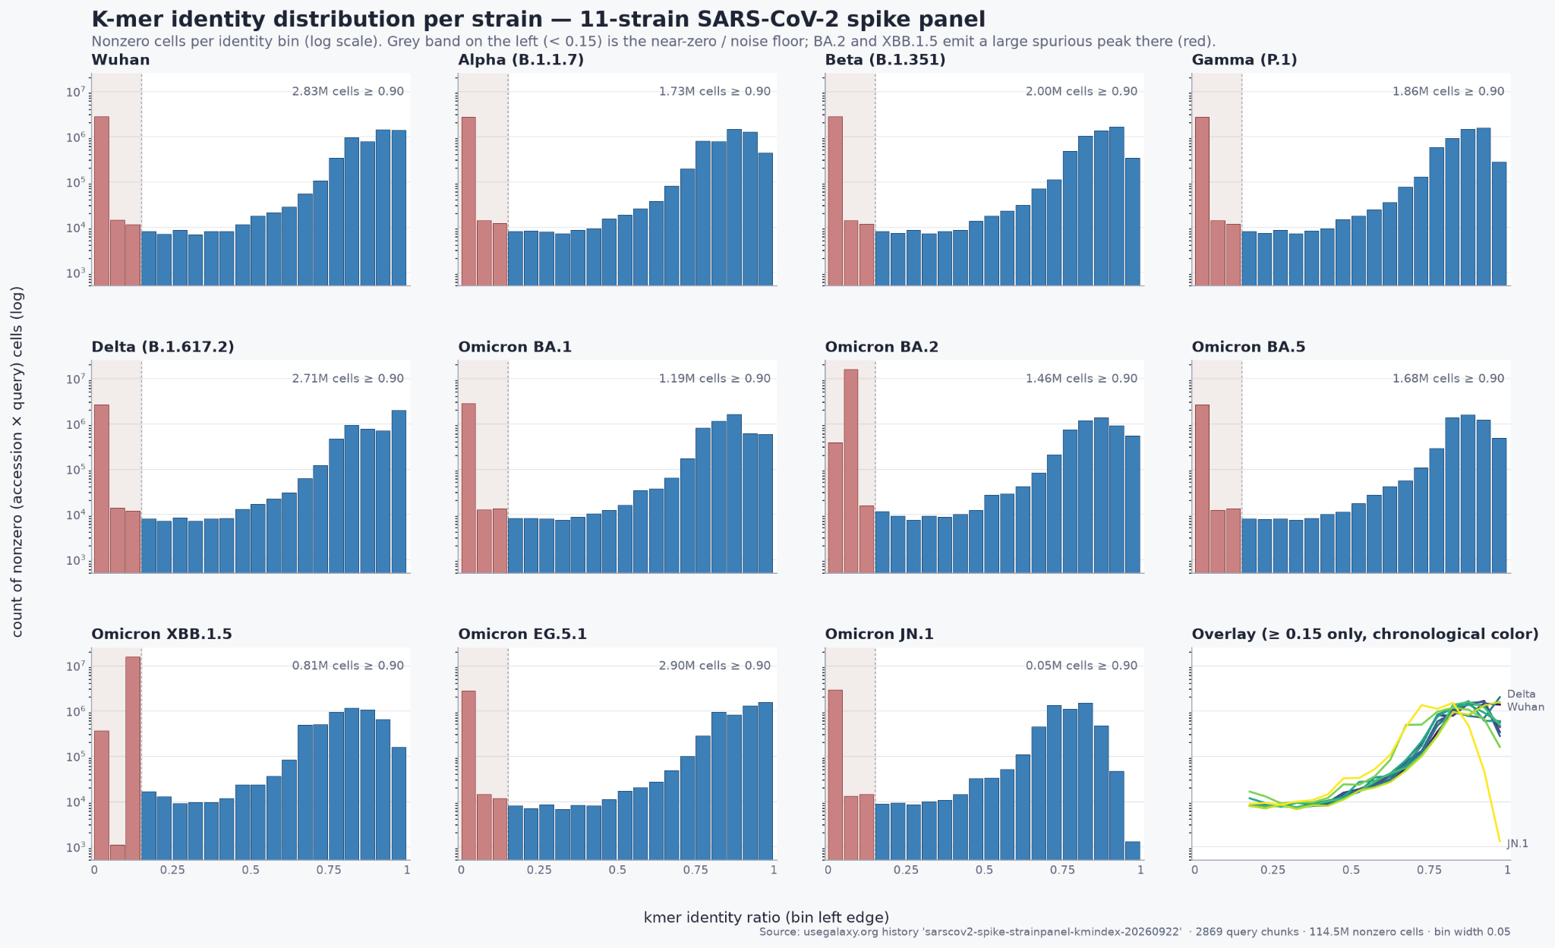
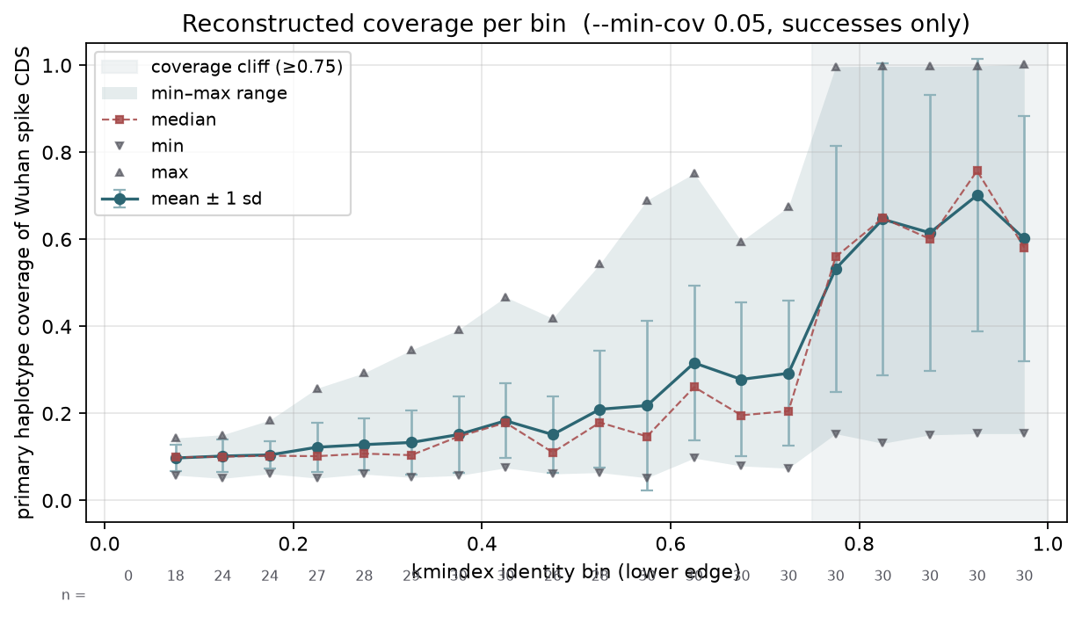
SARS-CoV-2 Spike Protein Case Study
Kmindex pathway was tested via 11-strain panel of Covid spike CDS
Goal was to develop intuition regarding the kmer identity percentage

Slide 11
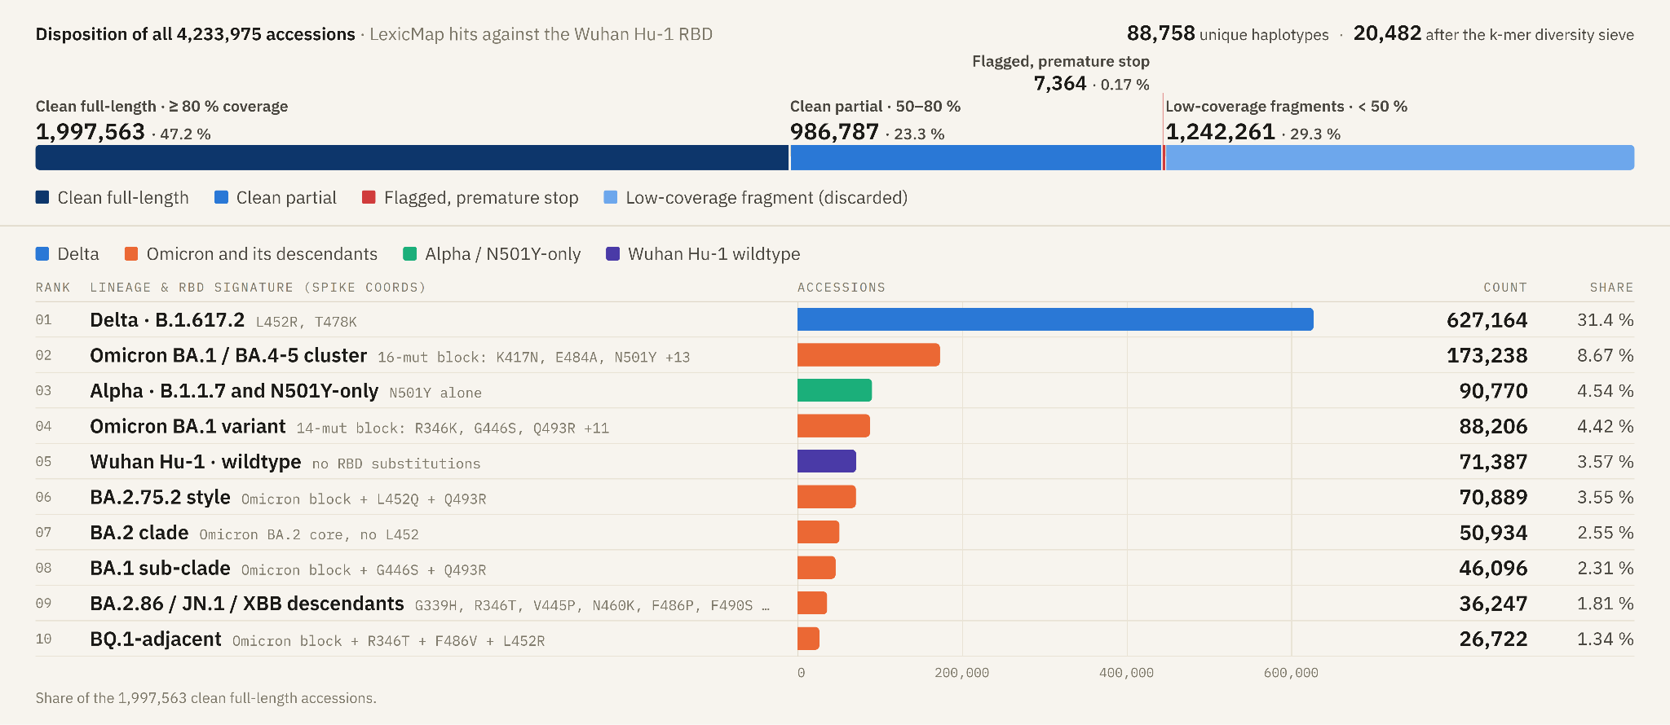
SARS-CoV-2 LexicMap RBD Case Study

Slide 12
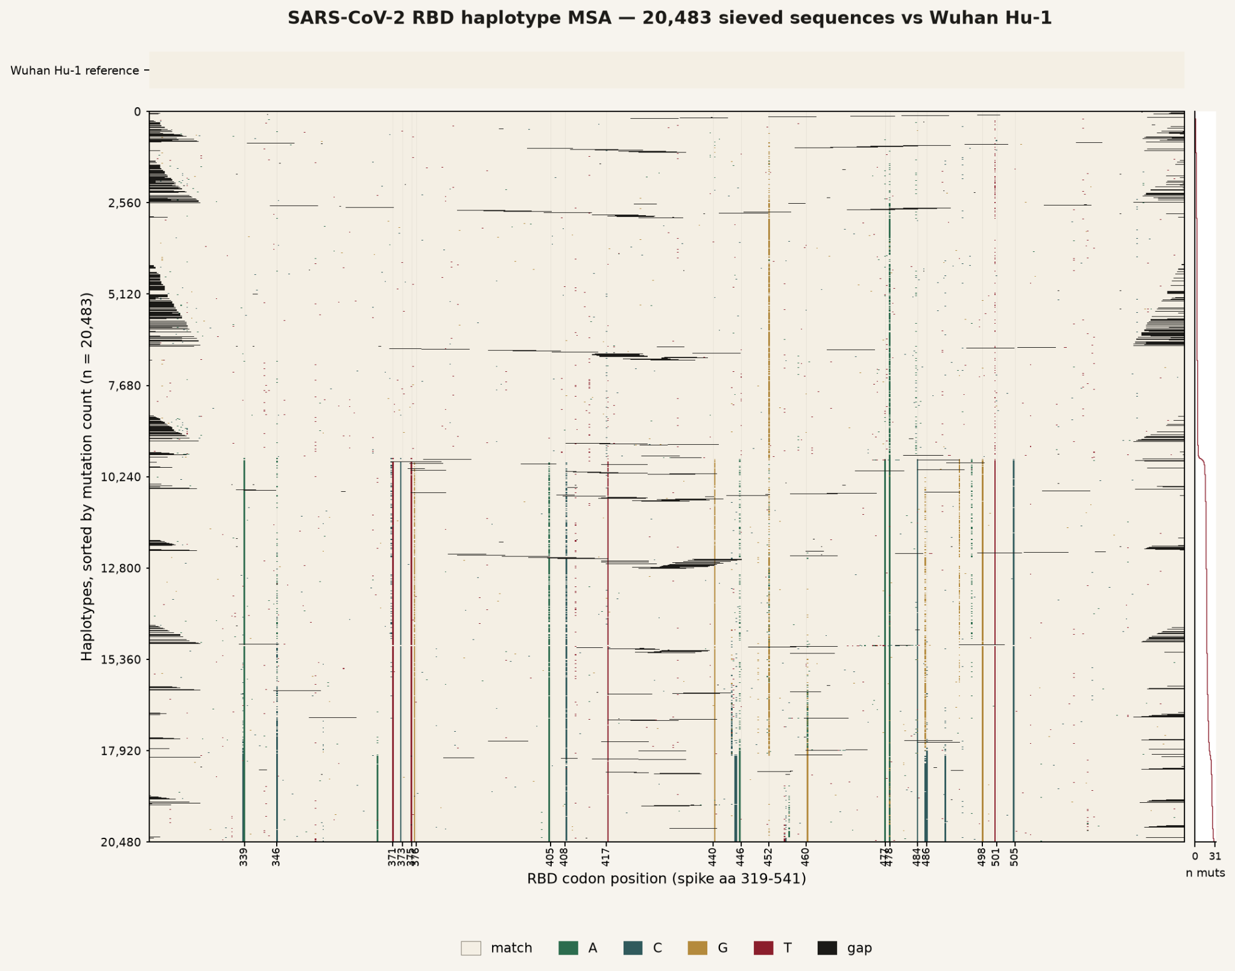
SARS-CoV-2 LexicMap RBD Case Study — Map

Slide 13
What is Next?
Galaxy tools/workflows
HyphAeon and ChronAeon analysis
Intra-accession variance analysis
Case studies for fast-diverging genomes (e.g. HIV)

